Slide 1
IUC fitter forum 2022
Jane Bush
Clinical lead for Contraception
Devon Sexual Health- Exeter

Slide 2
Plan for the evening
Update
Levosert
Pain control during fit
Interesting cases
Networking
Sharing ideas and practice
Meet our team of fitters

Slide 4
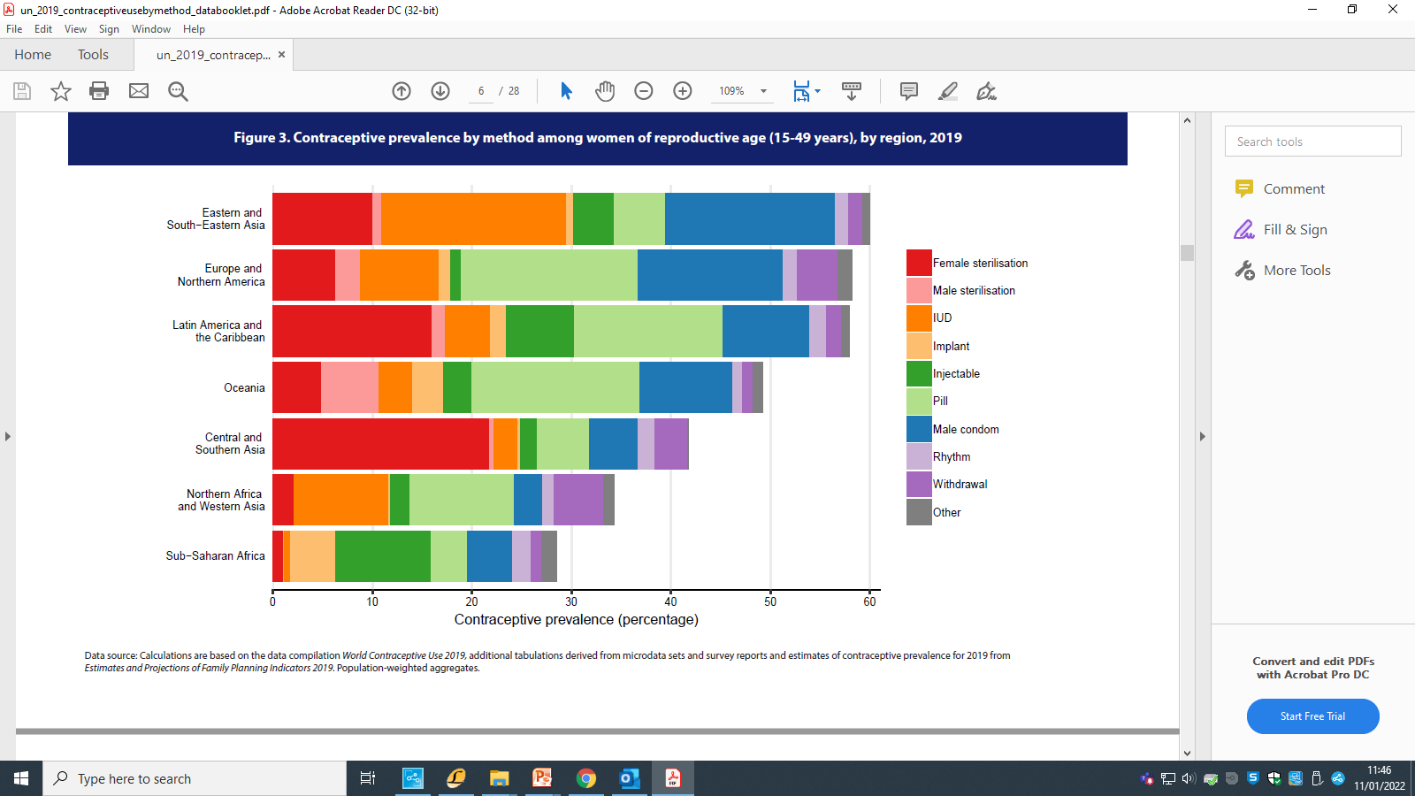

Slide 5
DSH (all 3 hubs)
Last 12 months:
2,314 IUCs fitted for contraception purposes
(pre-pandemic levels)
Primary care activity?

Slide 6
FRSH guidance
UKMEC 2016
CEU Intrauterine Contraception 2015- updated 2019
CEU Emergency contraception 2017- amended 2020
CEU Contraception for women aged over 40 years 2017
All available on FSRH website
NICE QS Contraception 2016.
nice.org.uk/guidance/qs129

Slide 7
What are we fitting?
Hormonal IUS
Mirena
Levosert
Kyleena
Jaydess
Benilexa?
Copper IUDs
T Safe Cu 380A /QL
Nova T 380
Neo-Safe T Cu 380
IUB?
Others?

Slide 8
Levosert
Equivalent to Mirena- 52 mg LNG
Same size frame- 32mm x32mm
Insertion tube diameter 4.8mm (Mirena 4.4)
Blue threads rather than brown
2 handed inserter
Contraception licensed = 6 year
BUT NOT licensed for endometrial protection
Cost- £66 (Mirena £88)
Makes Levosert the most cost effective LARC

Slide 9
Levosert
We consider in :
Parous women
< age 40
Any thoughts?

Slide 10
For how long can a 52mg LNG-IUS be used?

Slide 11
The answer is………..
If fitted >/= 45yr- can be used till age 55 then remove (FSRH CEU guideline, Contraception for women aged over 40 years)
Can be refitted at any time with in 7 years of fit if PT negative + advise repeat PT 3w later (off label) !
Use up to 5yr as part HRT regime (off label)-Mirena only
If using just for bleed control? For as long as it works…

Slide 12
IUS for non contraceptive reasons
IUS as endometrial protection with HRT
Use off label for up to 5yrs BUT not over no matter age of user
We are NOT commissioned to provide IUS unless for contraception use
We are not a gynae assessment service
Negotiations with CCG/amendment to formulary

Slide 14
What do we do and why

Slide 15
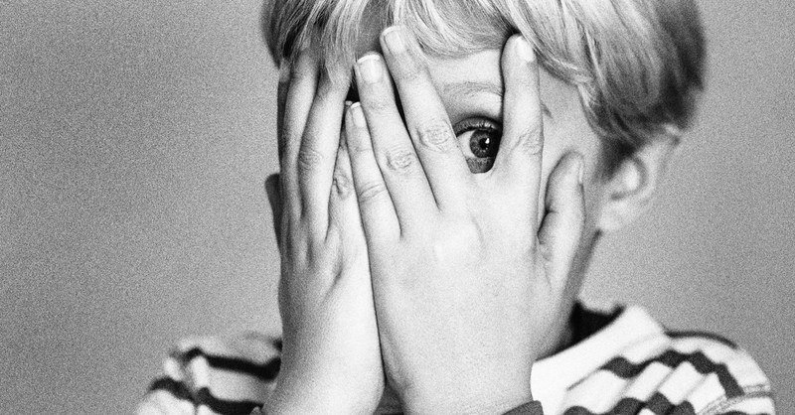
What challenges you most?

Slide 16
Key points……
No evidence that cervical cleansing reduces risk of pelvic infection
Routine cervical dilatation is not required
Use of anaesthetics
Screening- if asymptomatic can screen and fit on the day- no need for antibiotic prophylaxis

Slide 17
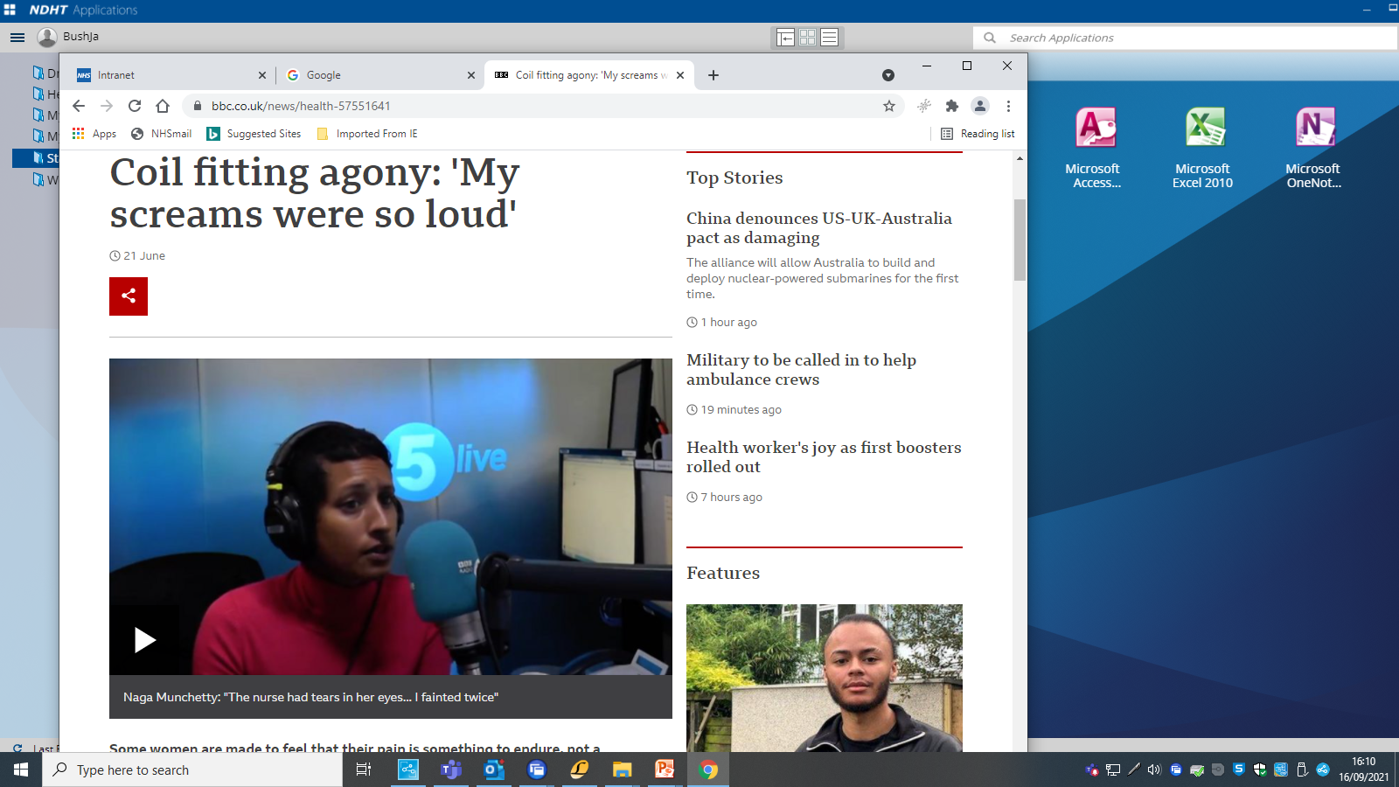

Slide 18
Xylocaine spray
4 puffs to cervix
Wait 3 minutes

Slide 19
Must haves………
Training- LocIUT
Consent….verbal or written?
An appropriately trained assistant.
Vulsellum.
Uterine sound.
Atropine and Oxygen ( FSRH service standards 2016)
Useful items : broad speculae, cytobrushes, silver nitrate sticks, spencer wells forceps.

Slide 20
Post fit advice
Abstain?
Extra precautions?
Use of tampons, mooncups, gym vibration plates, MRI scanners?
Thread check?

Slide 22
Follow up and on going management
6w check- not essential but….
Non visible threads?
Low lying IUCs?
Unscheduled bleeding with LNG-IUS- ? COCP/Red flags
Difficult removals?
Consider ectopic in any one with IUC with pain and/or bleeding

Slide 23
IUC pain/bleeding
What do we need to exclude

Slide 24
PID with IUC
Do you keep the IUC in situ?
When should you review?
When should you consider removing the IUC?
How soon could you refit an IUC post PID?

Slide 25
Risk of perforation
EURAS study- published 2014
46,000 recruited
similar risk for IUD and IUS
Perforation rate in non breastfeeding women = 0.67/1000
6 fold increase in breastfeeding women
Increased risk in <30w post partum
3.9 fold increase if fitting <50per year
No permanent or serious complications

Slide 26
When would you not fit?

Slide 27
Care with……
Pregnancy risk.
Cardiac disease: high risk of vasovagal- should involve cardiologist and fit in hospital setting
Post pregnancy: immediate fit at partum or >4w post natal- care re perforation ( breast feeding).
Post MTOP?
Other situations………?

Slide 28
Cases
Perforation in MSM
Ectopic pregnancy
Any others ?

Slide 29
Any further issues?
Contact us- e referral
Email: jane.bush@nhs.net
www.devonsexualhealth.co.uk
FSRH guidance and news statements

